Slide 1

Is it generally profitable to purchase a home for the purposes of renting out as an investment, or not?
Michelle Shum, #13488168
ECON 390

Slide 2
The Data
Panel data; we are observing changes in the variables. Monthly data from Jan 2015 to Sept 2023.
Data is for entire nation of USA
Housing data from Zillow, the leading real estate marketplace.
https://www.zillow.com/research/data/
Mortgage rates USA
Variables used:
Y variable: ‘number of units sold’
X variable: ‘mortgage rate’, ‘median house price’ and ‘rent yield’

Slide 3
Conclude that: No, it not profitable to purchase a home for the purposes of renting out as an investment.
We also analyze how the the number of units sold is affected by the mortgage rate, median house price and rent yield
Rent yield: (Annual rental income / median house price) * 100
To calculate the potential return on investment through rental income.
A higher rent yield generally indicates a better income-generating potential relative to the property's cost.

Slide 4
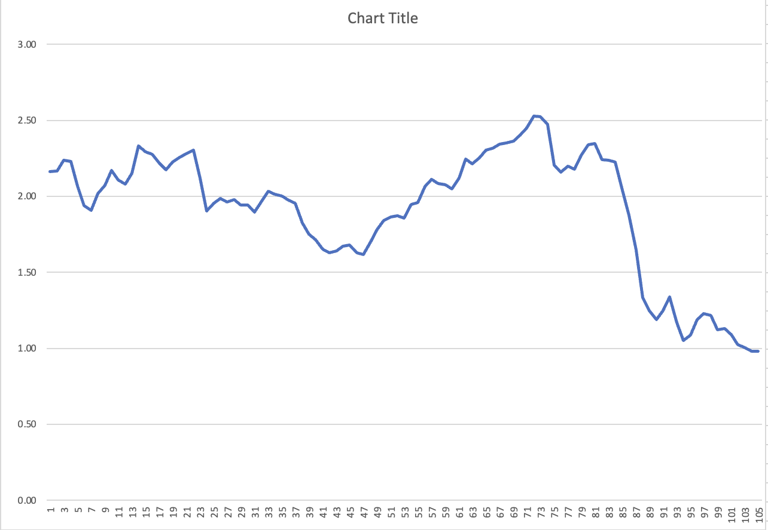
Rent yield & Rent-t0-payment ratios
Between 2015 and 2023, rent yield goes from 8% down to 7%.
Meanwhile, mortgage rates goes from 3.67% up to 7.20%, representing that there is no return on investment when rent yield is equal to mortgage rates.
(The rental income is sufficient to cover the mortgage payments.)

Slide 5
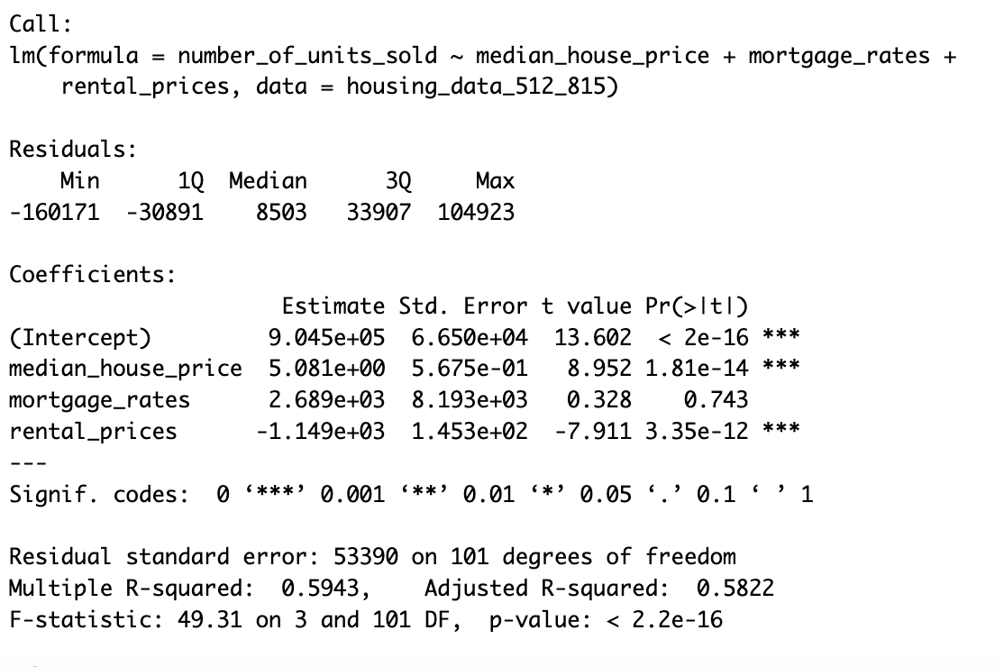
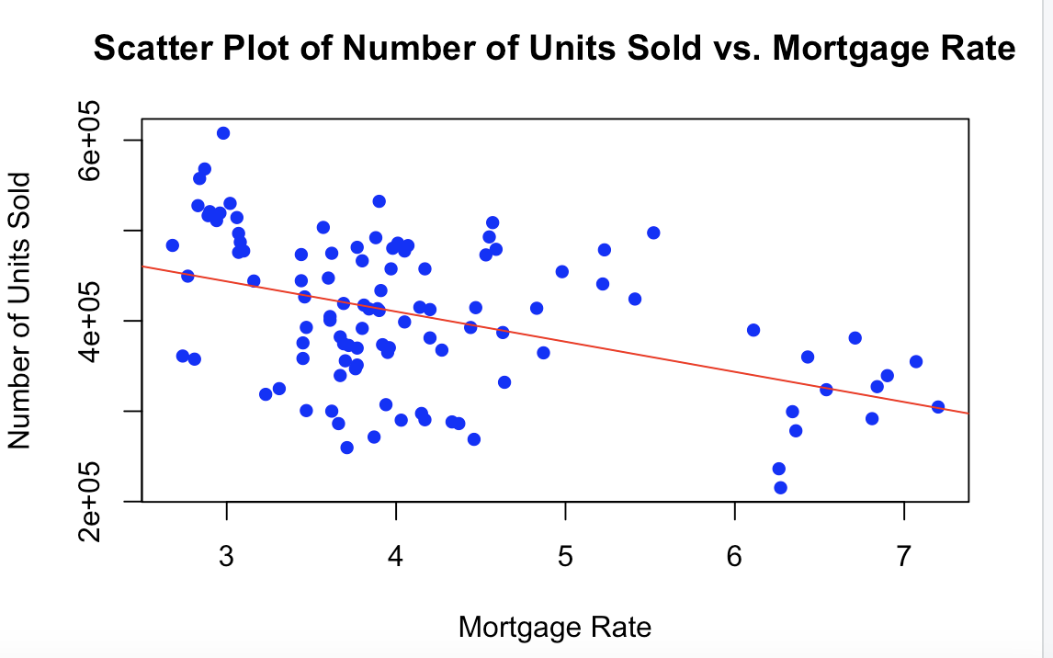
Regression: - The model suggests that median house price and rental prices are significant predictors of number of units sold. However, mortgage rates does not appear to be a significant predictor in this model.
In terms of whether it's worth renting a house for investment, this model suggests that rental prices and median house prices are important factors

